Slide 1
FEGO Digital Engineering Platform
Platform to accelerate application assessment and Cloud Migration

Slide 2

FEGO Digital Engineering Platform
Automate and Scale application cloud transformation with FEGO
Automated Cloud Readiness Assessment
From On-prem to target cloud
From one cloud platform to other cloud platform (PCF to OpenShift)
Service Templates
Accelerate Microservice Development
CI/CD Pipelines
Remediation Templates
Configurable Migration Settings
Transformation Recipes
Plugin integration
FEGO is an Intelligent Acceleration Platform for Application Cloud Transformation and Greenfield Application Development. It provides one click automation of cloud readiness assessment. It automates steps for transformation and deployment.
CUSTOMER ADOPTION: 100+ Customers
2

Slide 3
Cloud Transformation Approach with FEGO
Assessment and Transformation of Application using FEGO
Run Automated Assessment in FEGO
Further Iterations
Collect Transformation Requirements
VSM
Review and strategize transformation approach
Establish Cookbook
Run Automated Transformation in FEGO
Deployment Successful
Identify tech stack suitability, migration complexity and Migration Strategy Recommendation
Further manual changes may be required
The CI/CD pipelines created by FEGO can be reused for further iterations
Collect Transformation Requirements on shortlisted applications
Set up series of discussions to understand the transformation requirements and preferences
Identify required remediation templates, transformation recipes, service templates, CI/CD templates
Establish Application Migration cookbook
Modify existing recipes to customer context, if required
Create new recipes, remediation template actions, transformation recipes, service template types, CI/CD templates
Modified source code will be available on a new Git branch (or in the local file system in case of FEGO Local)
Updated cookbook as a reference for future migrations
Run FEGO and apply remediation templates, transformation recipes, and/or service templates
Application, if cloud ready, will be deployed to target cloud platform using the CI/CD template

Slide 4
FEGO Installation Requirements
FEGO can be set up on Desktop / VM
FEGO Pre-requisites
OS & Memory : Windows 10 & above with 16 GB RAM
Software : Java 1.8 Update 161 & above. It is not certified with Java 1.9 & above.
Google Chrome browser
Internal Ports used : 8088, 8001, 5672, 8080 – No need to open them publicly.
FEGO as a standalone application can be installed locally on the desktop. FEGO installer is a Zip file. README.md file has the instructions for the installation.

Slide 5
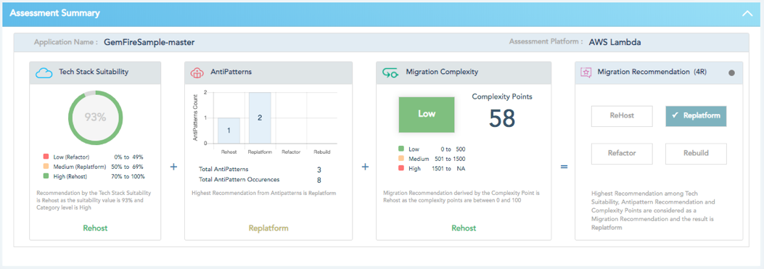
Sample Assessment Report - Application Details
Migration Complexity
- The complexity level in migrating the application to cloud and the total complexity points to consider for application migration to Cloud
Assessment Details
- App name and the target platform
Tech Stack Suitability
- Suitability of the application tech stack to fit into a target cloud
Antipatterns
- A summary on the anti patterns detected in the application.
Migration Strategy
Provides the migration strategy for the application based on entire analysis.
Rehost - Lift And Shift Strategy
Replatform - Changes to be done at platform/framework level before migrating to cloud
Refactor - Refactoring to be done in the code to migrate the application to cloud
Rebuild - Rebuild the entire application as the existing code base will not fit in cloud.

Slide 6
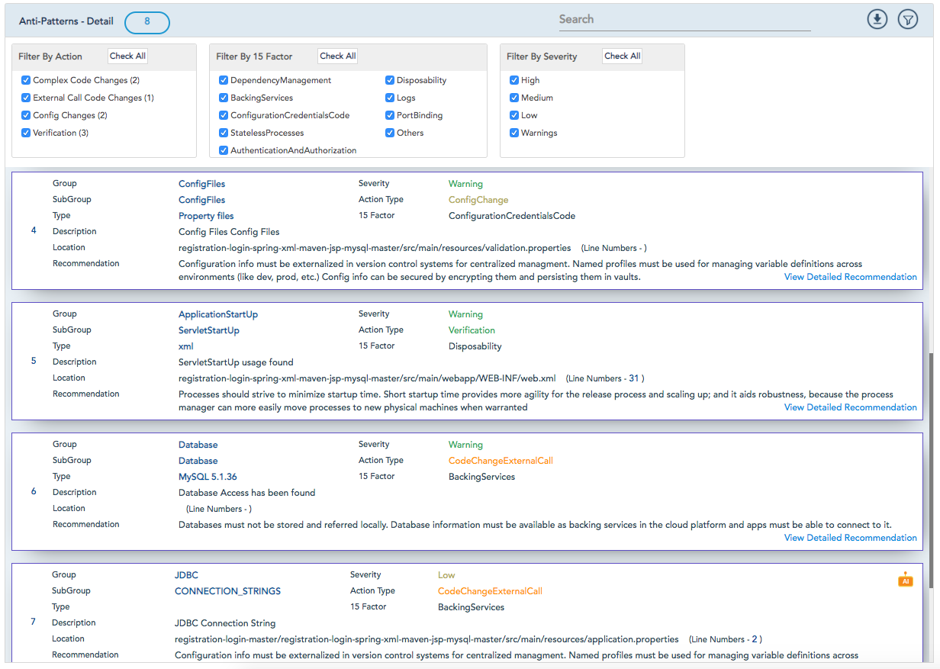
Sample Assessment Report - Anti Patterns Details
Recommendation
High-level recommendation is available here.
Detailed recommendation for each anti-pattern can be viewed by clicking on ’View Detailed Recommendation’ link.
Anti-Patterns Detail
- Provides the details of each anti-pattern encountered in the application
Filter
- Provides an option to filter the anti-patterns based on severity, 15 factor, action and any text entered
AI Assessment
- Highlight indicates that the anti-patterns are identified through machine learning module of VSM

Slide 7
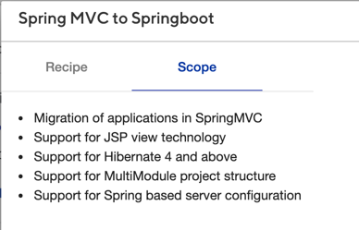
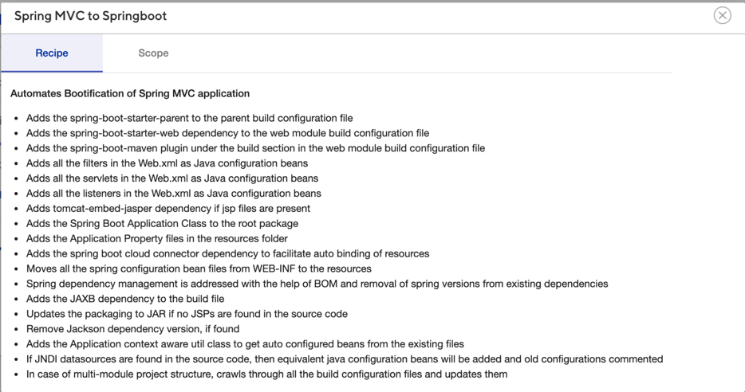
Example: SpringMVC to Spring boot Recipe
Transformation Recipe Steps
Transformation Recipe Scope
Example highlights the steps to transform codebase from SpringMVC to Springboot framework
Platform crawls through the application source code, understands current landscape and suggests target framework to transform application for Cloud
Upon user confirmation, platform transforms source code to target framework
In addition to automated transformation steps, FEGO platform also provides suggestions on the manual steps to be performed (if any)

Slide 8
What FEGO will not address
FEGO Cloud assessment coverage does not include the Databases, Infrastructure & System DLL/JAR’s details.
FEGO Cloud assessment does not assess the security vulnerabilities.
FEGO Cloud assessment does not support war files.
FEGO Cloud assessment on the application specific DLL/JAR’s does not roll up to its final Migration Complexity Points or Recommendations
FEGO Cloud assessment can be done for Java and .NET COTS products as long as the source code is available. FEGO does not support Transformation of COTS products as it is the vendor’s responsibility and they are in a better place to perform the transformation.
FEGO platform will not provide recommendations on the target Infrastructure.
FEGO platform supports framework level changes to run the application in cloud. Example: Struts to Springboot transformation.
Some of the identified antipatterns can be fixed using Remediation templates configured by user. FEGO does remediate all of the identified antipatterns.
FEGO does not support database migration and data migration.
FEGO currently provides a set of recipes for framework level changes. To address problem areas for which support is not available, new recipes can be created in shorter release cycles.
With respect to CI/CD tools, only Jenkins service is supported currently. Customization effort would be involved to integrate other CI/CD tools.
FEGO platform currently only supports transformation of:
Java applications with Maven / Gradle as build tool and packaged as jar / war
.NET applications of type ASP.NET 2.0, 3.5, 4.5 & Classic ASP

Slide 9
Thank You
TeamFEGO@cognizant.com

